Slide 1
Genshin Impact: Intro to Combat Mechanics

Slide 2
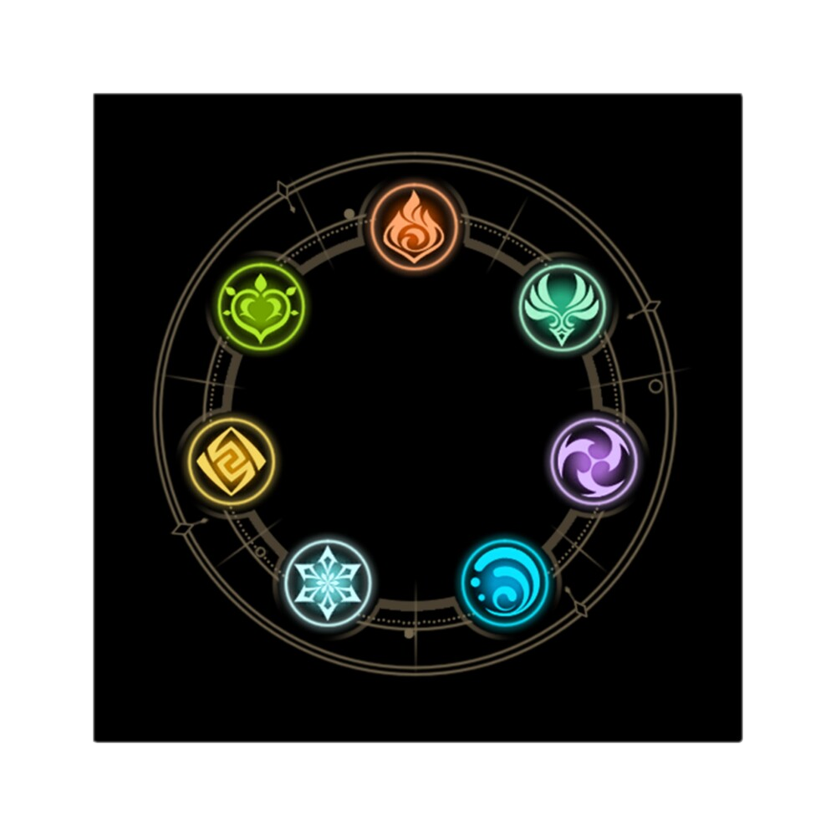
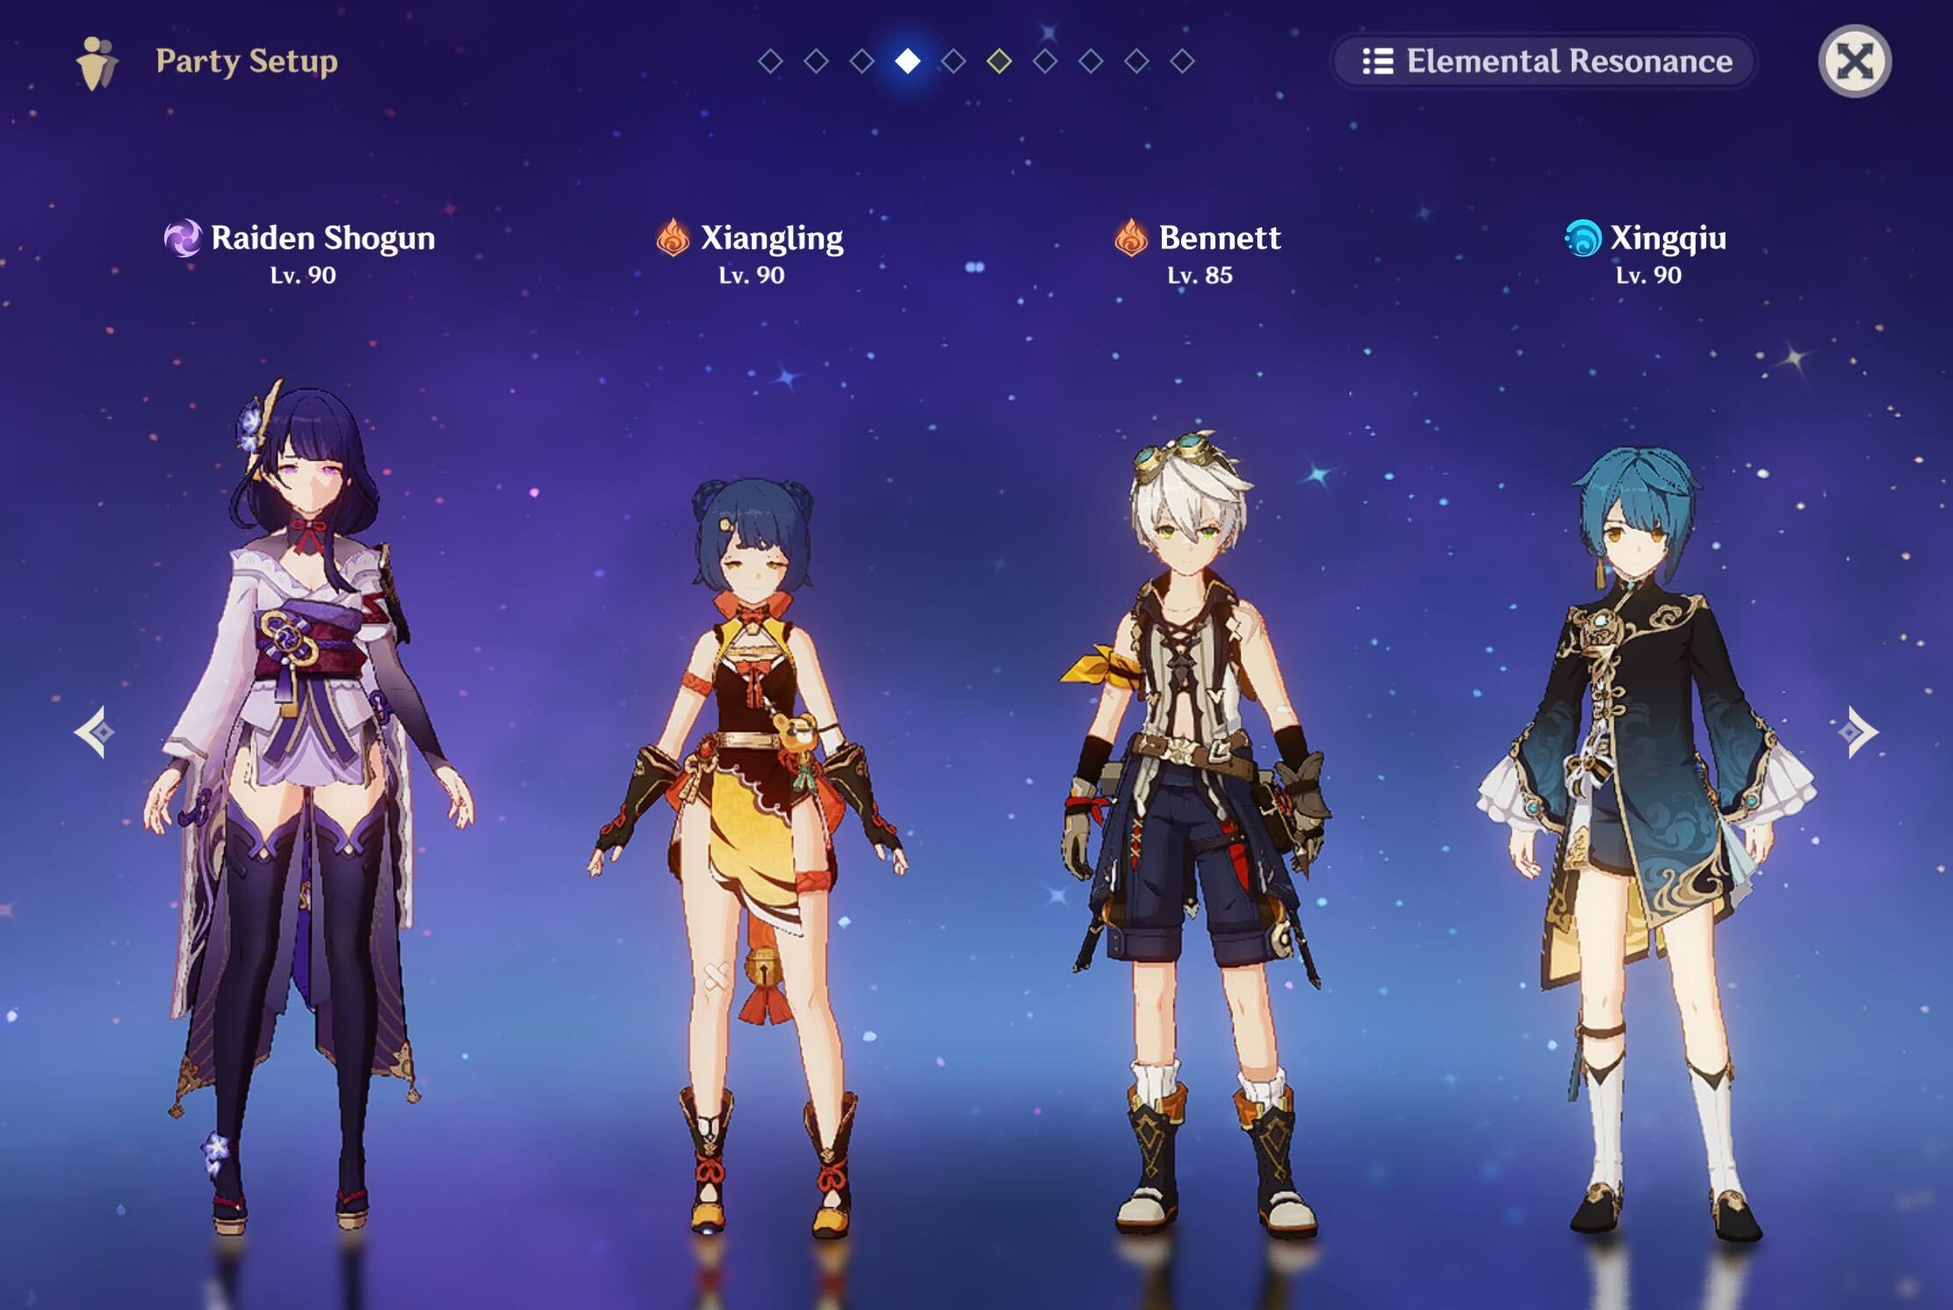
Steps To Mastering Combat
Draft a team
Pick a carry
More general reaction teams
Unique synergies (Ex: Geo)
So many options!
Build each character
Level and Talents
Weapons
Artifacts
Plan and execute Rotations

Slide 3
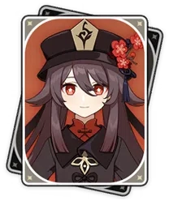
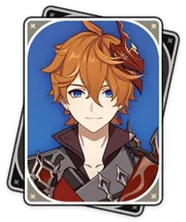
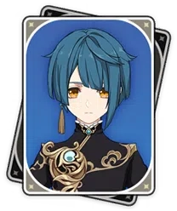
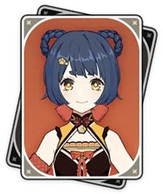
Team Roles
On field characters
Can be DPS or Enablers
Generally one per team
Off field damage
Can be DPS or Enablers
Can often fit more than one

Slide 4
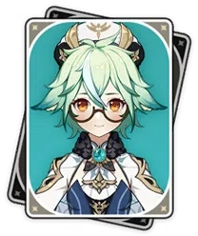
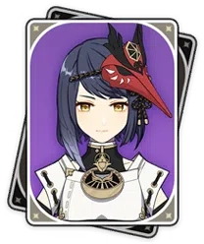
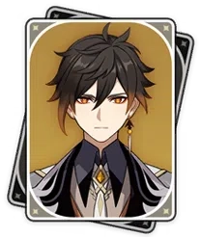
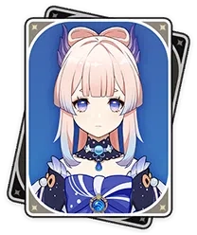
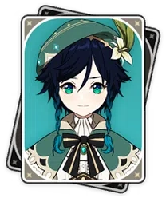
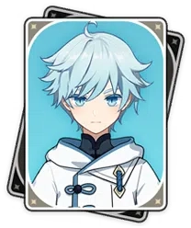
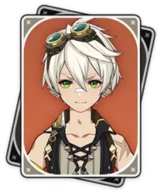
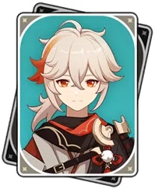
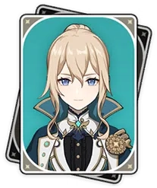
Team Roles cont.
Buffers Heal/Sustain Crowd Control/Utility
Many characters overlap categories:

Slide 5
Team Composition
On field damage: 0-1
Off field damage: 1 – 3
Buffers: 1 to 2
Healers: 0 - 1
Star rating is generally less important than expected
Often beneficial to pair same element characters for energy

Slide 6
Essential Buffs
RES shred
Viridescent Venerer
Zhongli Shield
ATK Buffs
Bennett
Sara
Thrilling Tales
DMG/Crit/Other Bonuses
Kazuha
Yelan
Yunjin
Shenhe
Gorou
Mix buff types to minimize opportunity cost

Slide 7
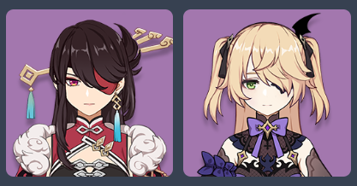
Energy and Batteries
You need to burst ASAP
Bursts are very good, so you need the energy for them
Elemental Skills generate energy particles
ER stat boosts energy received, not generated
More energy if caught on field (x1.66)
More energy if same element (x3)
Run a carry with a battery if needed
Depends on the character, can search if needed

Slide 8
Elemental Gauges
Aura, then Trigger
Aura elements:
Hydro, Electro, Pyro, Cryo, Dendro
Any Element can Trigger if an Aura is present (Exception: Dendro + Geo/Anemo/Cryo)
Some elemental reactions consume certain Auras faster
Pyro > Cryo
Hydro > Pyro
Dendro > Hydro
Any Aura > Anemo or Geo
Weak Side reactions consume half a unit of aura per unit of application
Strong Side reactions consume two units of aura per unit of application

Slide 9
Elemental Application
Character apply elements at varying strength and frequency
Either 1U, 1.5U, 2U, or 4U
If more element is applied than existing aura, none of the applied element become aura
Application (per enemy per attack type) is limited by Internal Cooldown (ICD)
Application occurs on first hit, then again after 3 additional hits
If 2.5 seconds pass, the hit rule is reset (next hit applies element)
Many characters don’t follow standard ICD

Slide 10
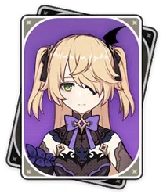
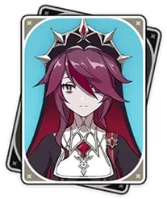
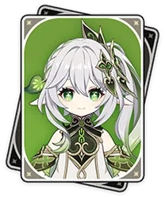
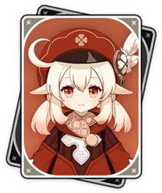
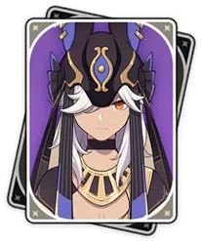
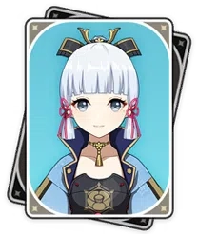
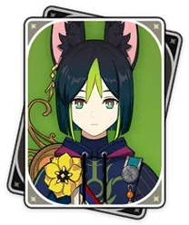
Dedicated Aura Applier examples
Off Field:
On Field:

Slide 11
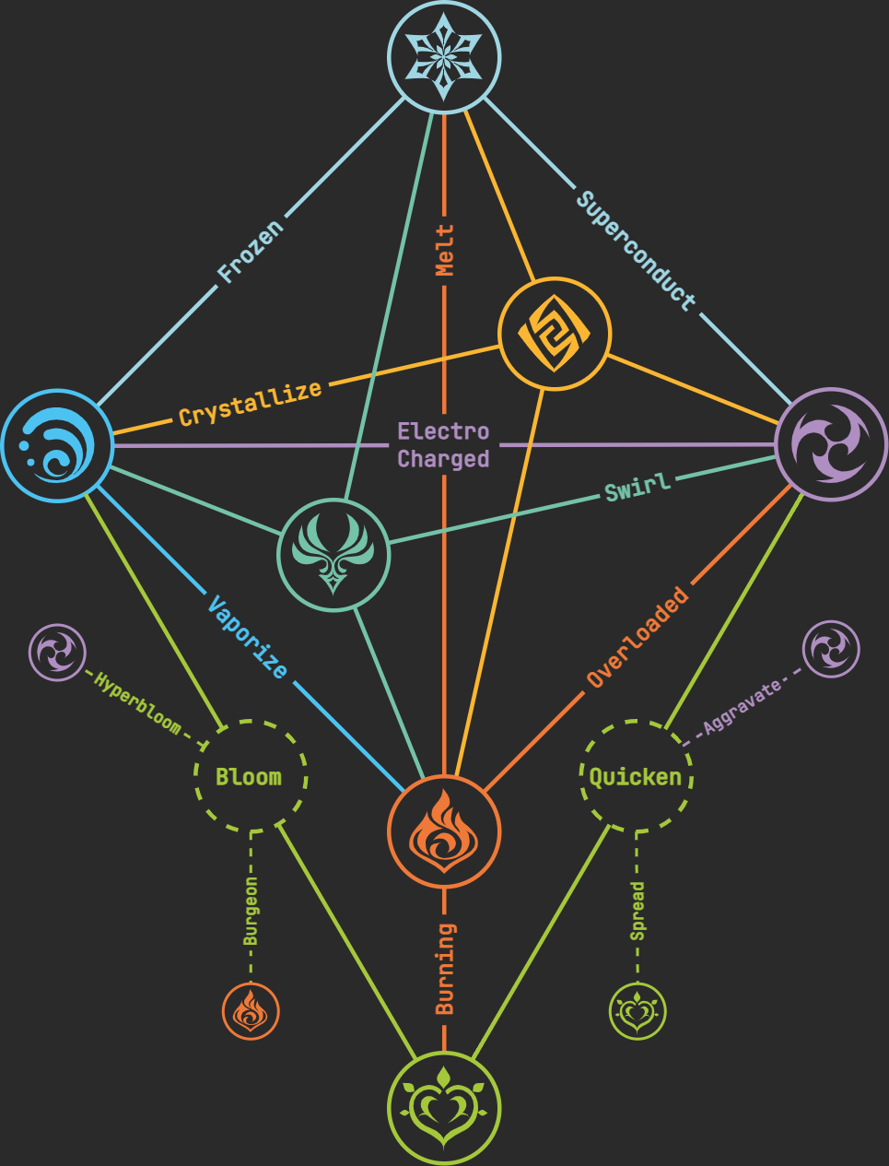
Team Elements and Reactions
Vaporize/Melt
Freeze
Electro-Charged
Bloom
Quicken
Superconduct
Geo
Soup
Pure

Slide 12
Vaporize
Amplifying reactions boost applied damage by a scale factor
Important to build a main damage dealer with Crit/ATK/DMG and some EM
Hydro is the Vaporize base
Reaction goes both ways, but Hydro removes pyro quickly, so Hydro is generally aura
Bring at least one consistent Hydro aura applier & one Pyro trigger who has the strongest stats
Pyro damage dealer will want the EM more than the Hydro

Slide 13
Melt
Pyro is the Melt base
Reaction goes both ways, but Pyro removes cryo quickly, so Pyro is generally aura
Bring at least one consistent Pyro aura applier & one Cryo trigger who has the strongest stats
Cryo damage dealer will want the EM more than the Pyro

Slide 14
Freeze
Freeze reaction stops enemy movement
This archetype is most likely to forego heal/sustain
Can’t freeze bosses
Requires consistent Hydro & Cryo application (AOE preferred)
Blizzard Strayer is nearly mandatory
Put this artifact on your Cryo carry and build them well

Slide 15
Electro-Charged
Electro-Charged doesn’t actually do main damage
Don’t need EM on Hydro/Electro Characters
Electro-Charged is a double aura: enables chain reactions
Use an Anemo character with high EM to abuse double Swirl + EC
Order of application and aura doesn’t matter

Slide 16
Soup
Mix of Transformative and Amplifying reactions
EM is important for the Anemo character, secondary but useful for everyone else
Generally composed of Electro, Anemo, Pyro, Hydro, and all their reactions
Cryo is anti-synergy in these teams
Dendro can also be slotted in

Slide 17
Bloom
Hydro and Dendro form Dendro cores
Cores explode and deal transformative AOE Dendro DMG
Dendro aura will yield more cores
Dendro Cores are upgraded when hit with Pyro or Electro
Burgeon: Cores + Pyro. Deals greater AOE Dendro DMG. Pyro application must be slow (Ex: Thoma) in order to prevent Burning (or add Hydro)
Hyperbloom: Cores + Electro. Deals greater single-target Dendro DMG. More commonly used
The one who procs the seeds needs EM to do Bloom damage

Slide 18
Quicken
Electro and Dendro generate a Quicken Aura
Quicken adds additional damage to Dendro or Electro whenever they react
Extra damage based on EM, CRIT, and DMG bonus
Either can be the Aura: Reaction order isn’t important, so rotations are flexible

Slide 19
Superconduct
Electro + Cryo reduces physical resistance by 40% (can be negative)
Doesn’t require much application – 1 reaction per ~8s is enough
Necessary reaction for physical damage carries
Generally requires focusing on a hypercarry with high investment and field time.

Slide 20
Geo
Geo reactions aren’t very important
Most Geo characters have kits designed around synergy with other geo units
Geo Resonance
Defense scaling and Defense buffs
Can struggle with elemental shields: inserting one other element can help

Slide 21
“Pure” teams
Focuses on buffing one element
Kazuha and other Anemo is a common staple
VV + DMG Bonus buffer
Generally doesn’t rely on any reaction other than Swirl

Slide 22
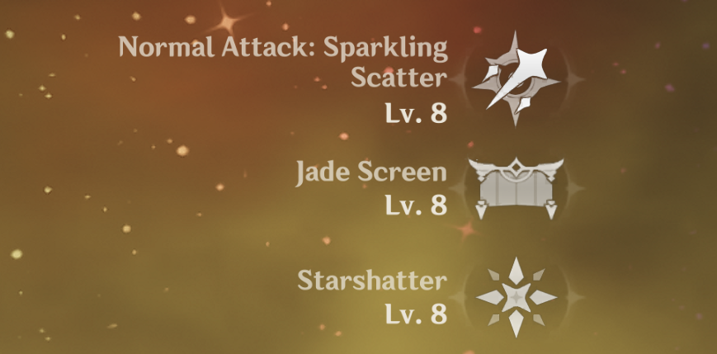
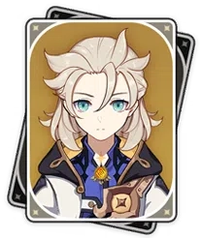
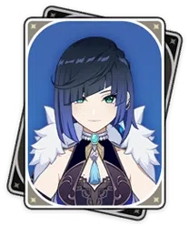
Character Building: Levels and Talents
Prioritize this before perfect artifacts
Talents are very important, but not all are useful
Off field Normal attack talents
Character specific details
Transformative reactions don’t use Talents
Levels increase DEF, HP, and Transformative reactions more drastically
Getting Characters that scale with these stats to level 90 will produce more noticeable affects

Slide 23
Opportunity Costs in Genshin
Many damage dealers scale off of multiple stats
ATK
EM
DMG Bonus
CRIT
In such cases, best to focus on all relevant stats
Optimization problem: max( xyz ) given x + y +z = c

Slide 24
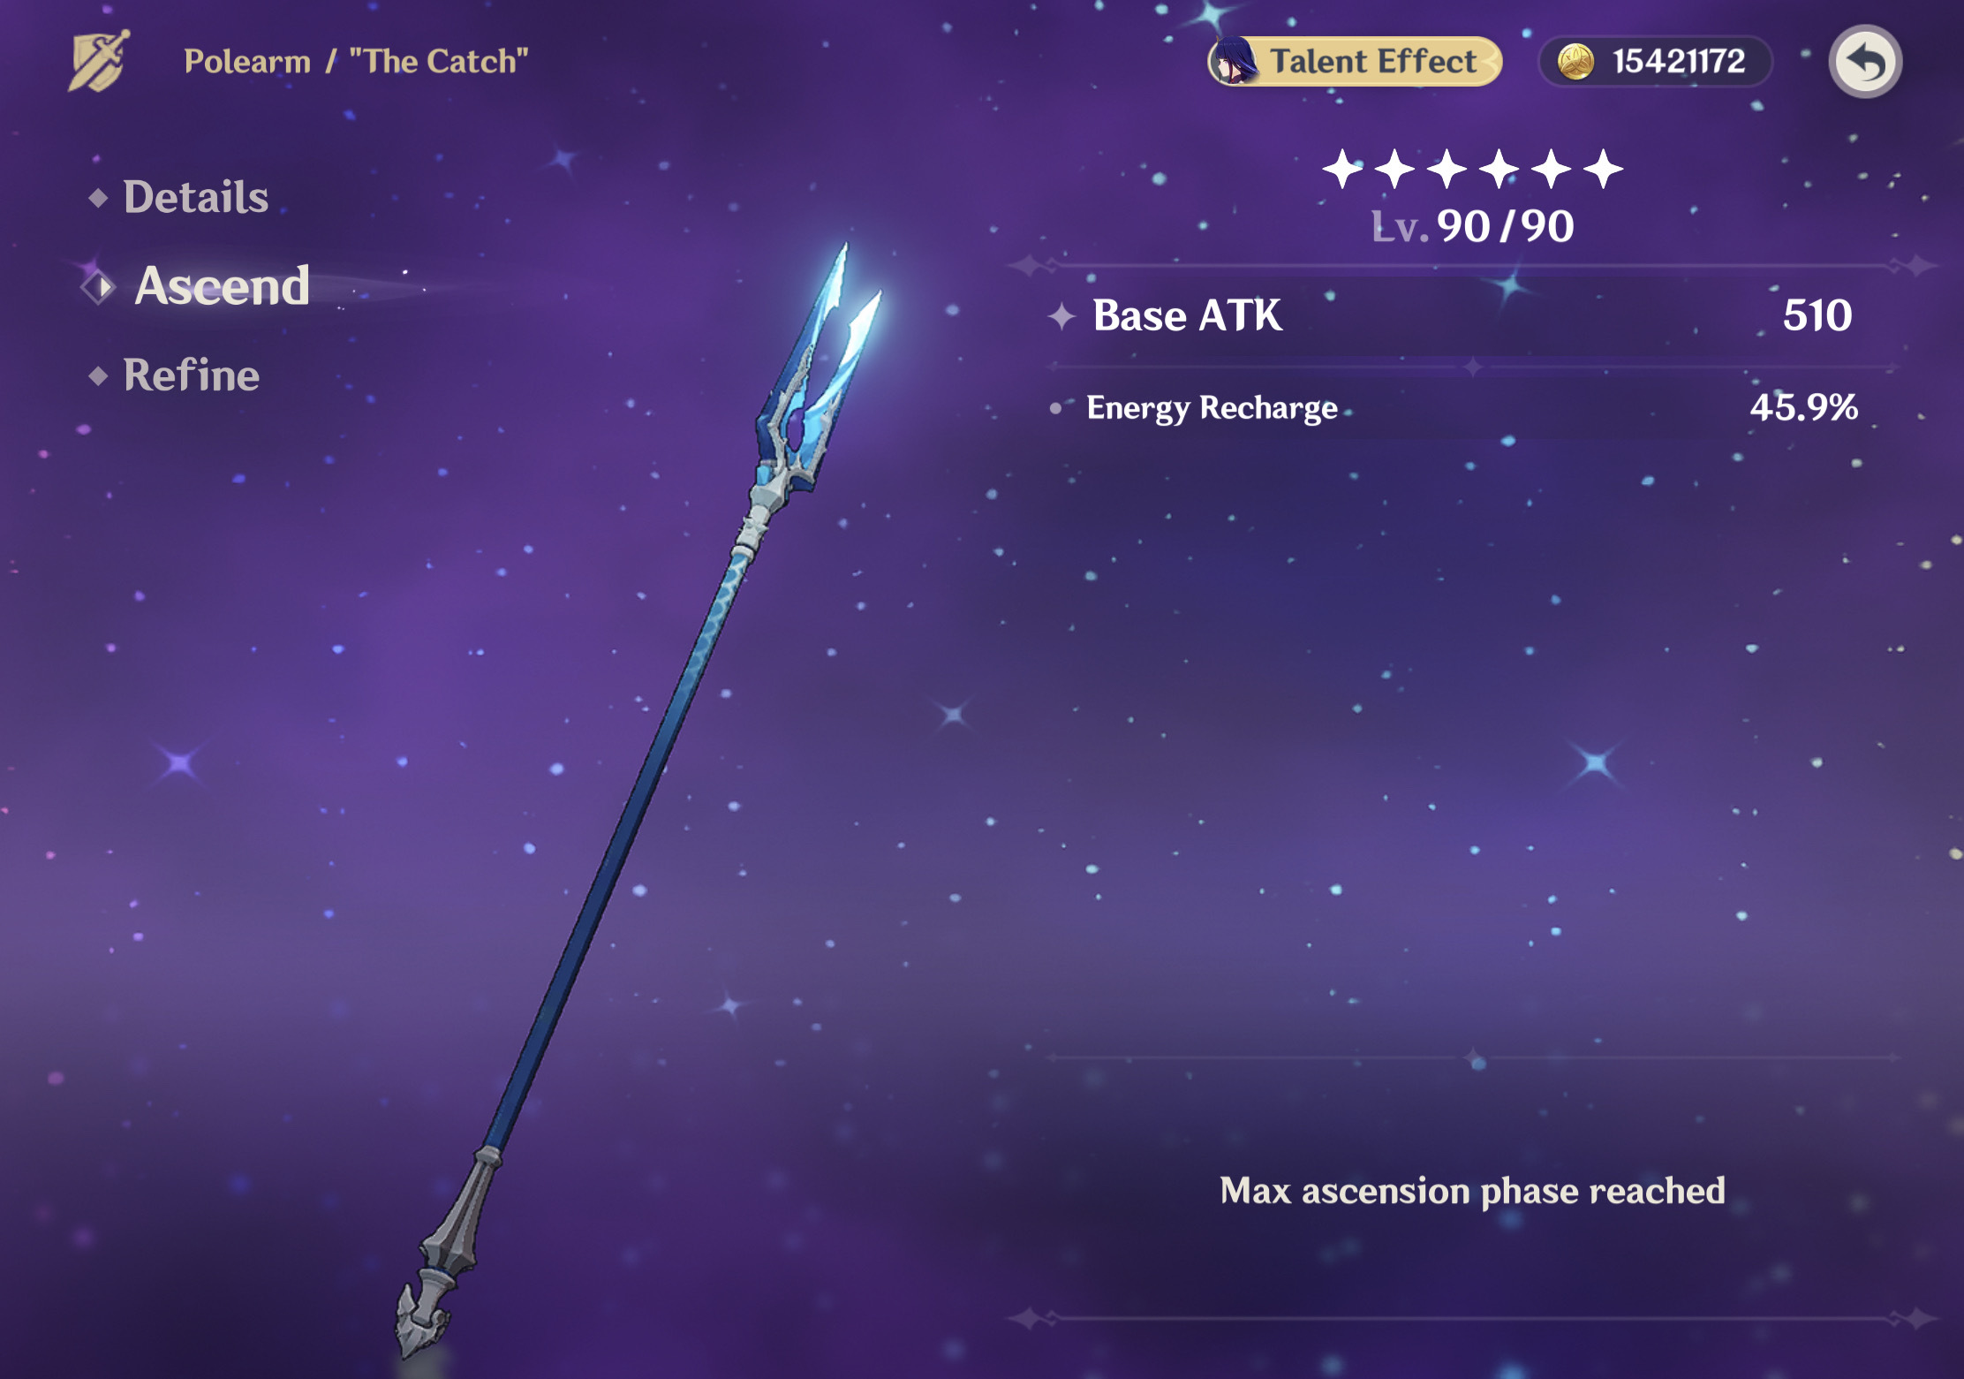
Character Building Weapons
Leveling a weapon is important and can give guaranteed damage
Pay attention to what weapon substat your character wants most
CRIT DMG/CRIT Rate
Energy Recharge
EM
ATK/DEF/HP
Some weapons have powerful bonus effects
Favonius Weapons
Serpent Spine
Widsith
Etc.

Slide 25
Artifacts
Priority: Main Stat > A useable Set Bonus > Substats > The best set bonus
DMG bonus goblet, CRIT circlet for most damage dealers
Some set bonuses are extra important: prioritize these when recommended
Viridescent Venerer
Blizzard Strayer
Husk of Opulent Dreams
General Purpose Sets: Very good to farm
Emblem of Severed Fate
Viridescent Venerer
Noblesse Oblige

Slide 26
Rotations
Cast necessary Skills and bursts in an optimal order, then repeat
Necessary Bursts and Skills should be done every rotation, with few exceptions
ENERGY IS VERY IMPORTANT
If you don’t have very consistent burst uptime, prioritize your energy recharge
Consider the order in which you cast your bursts and skills, and try to keep it consistent
Order your swaps in a way that optimizes buffs
Keep the uptime of your bursts in mind
Try to have things end around the same time: use longer lasting talents first
Minimize waste on bursts/skill that require inputs

Slide 27
Good Resources
KeqingMains (KQM)
Zajeff77

